Slide 1

B.Tech 6th Semester Minor Project Presentation
“HEART DISEASE RISK ASSESSMENT
WITH MACHINE LEARNING”
Presented by:
Soham Patil(210306105155)
Sagar Patil(210306105211)
Neha Arsgonda(210306105069)
Saurav Yadav(210306105126)
Supervisor:
Mr. Amar Chandra
PARUL INSTITUTE OF TECHNOLOGY, PARUL UNIVERSITY
NAME OF THE INSTITUTE, PARUL UNIVERSITY

Slide 2
Content of Presentation
Abstract
Introduction
Problem Statement
Proposed Methodology
Project Module
Use case diagram/ER diagram/Flow diagram
Hardware and Software Requirements
Excepted Outcomes of the Project
Limitation
Conclusion and Future Work
References
PARUL INSTITUTE OF TECHNOLOGY, PARUL UNIVERSITY
NAME OF THE INSTITUTE, PARUL UNIVERSITY

Slide 3
Abstract
Heart disease is a leading cause of death globally. Early detection and intervention are crucial for improving patient outcomes. This project explores the use of machine learning techniques to predict the presence of heart disease using a publicly available dataset. The project investigates the effectiveness of Logistic Regression in classifying patients based on their risk factors. The model's performance is evaluated using various metrics, and potential areas for future work are discussed.
PARUL INSTITUTE OF TECHNOLOGY, PARUL UNIVERSITY
NAME OF THE INSTITUTE, PARUL UNIVERSITY

Slide 4
Introduction
It is difficult to identify heart disease because of several contributory risk factors such as diabetes, high blood pressure, high cholesterol, abnormal pulse rate and many other factors.
Among various life-threatening diseases, heart disease has garnered a great deal of attention in medical research diagnosis of heart disease is a challenging task, which can offer automated prediction about the heart condition of patient so that further treatment can be made effective.
The nature of heart disease is complex and hence, the disease must be handled carefully. Not doing so may affect the heart or cause premature death
4
PARUL INSTITUTE OF TECHNOLOGY, PARUL UNIVERSITY
NAME OF THE INSTITUTE, PARUL UNIVERSITY

Slide 5

Problem Statement
Given the clinical parameters about the paitents, can we predict whether or not they have heart disease?
image courtesy of :
5
PARUL INSTITUTE OF TECHNOLOGY, PARUL UNIVERSITY
NAME OF THE INSTITUTE, PARUL UNIVERSITY

Slide 6
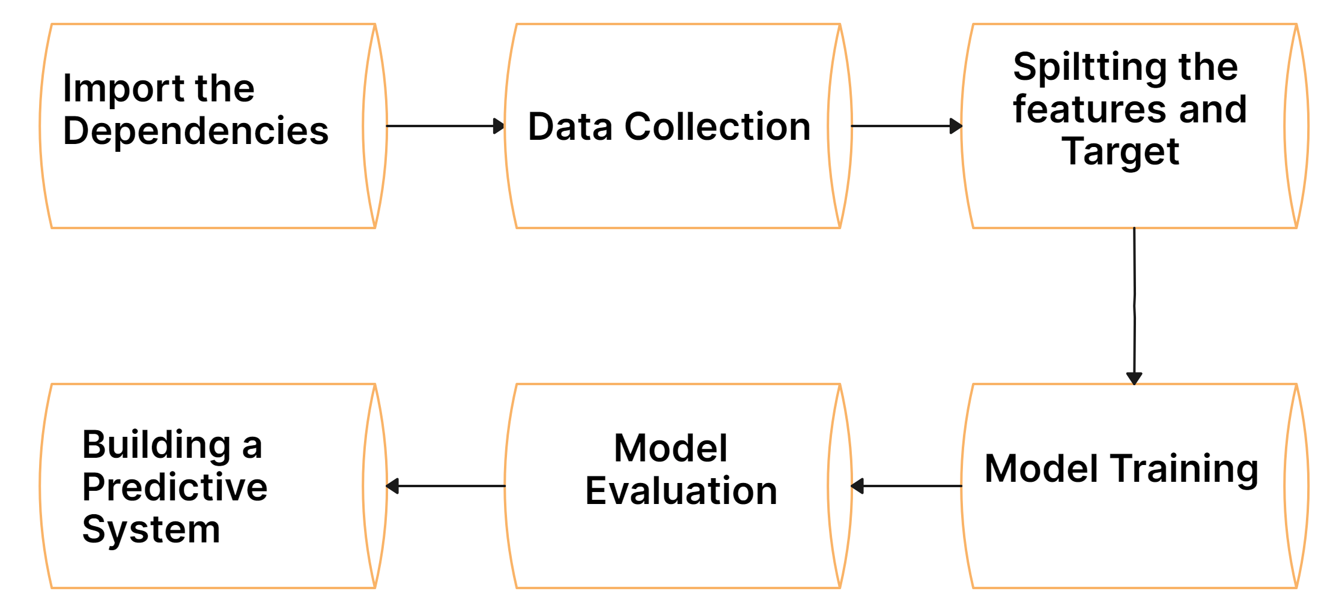
Proposed Methodology
PARUL INSTITUTE OF TECHNOLOGY, PARUL UNIVERSITY
NAME OF THE INSTITUTE, PARUL UNIVERSITY

Slide 7
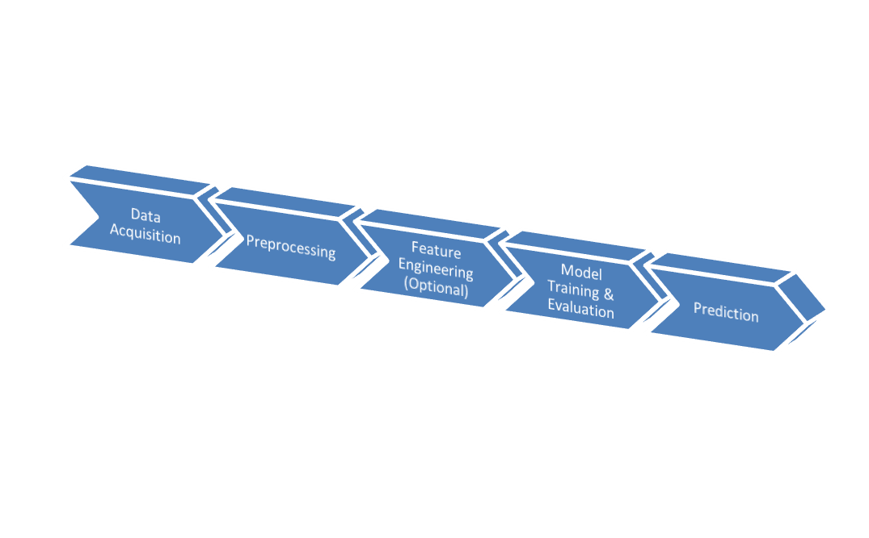





Project Module
PARUL INSTITUTE OF TECHNOLOGY, PARUL UNIVERSITY
NAME OF THE INSTITUTE, PARUL UNIVERSITY

Slide 8
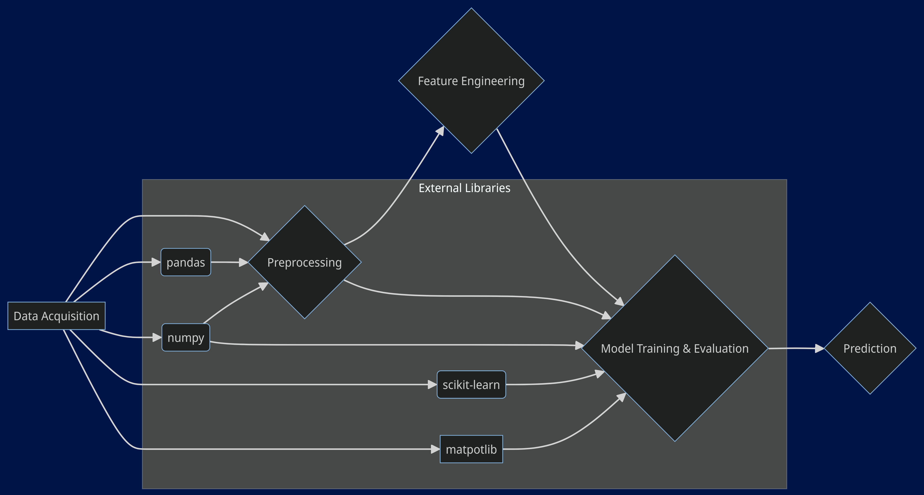
Use case diagram
PARUL INSTITUTE OF TECHNOLOGY, PARUL UNIVERSITY
NAME OF THE INSTITUTE, PARUL UNIVERSITY

Slide 9
Hardware and Software Requirements
Hardware Requirements:
  Processor (CPU): Mid-range, 2+ cores
  Memory (RAM): 8GB
  Storage: Varies based on dataset size
Software Requirements:
  Operating System: Windows 10 (or later), macOS, Linux
  Python (3.x): Latest version recommended
  Scikit-learn: Machine learning library
  Pandas: Data manipulation library
  Numpy: Numerical computing library
PARUL INSTITUTE OF TECHNOLOGY, PARUL UNIVERSITY
NAME OF THE INSTITUTE, PARUL UNIVERSITY

Slide 10
  Outcomes of the Project
Model Performance:
  Accurate Prediction of Heart Disease: The primary outcome is to develop a model that can accurately predict the likelihood of heart disease for new, unseen patients. This will be measured using evaluation metrics like accuracy, precision, recall, and F1-score.
  Improved Risk Assessment: The model should provide a reliable risk assessment tool, helping identify individuals at higher risk of developing heart disease. This information can be valuable for preventive healthcare measures.
Functional Machine Learning Model:
  The project should deliver a trained and functional machine-learning model that predicts heart disease based on input patient data.
Evaluation Report:
  A comprehensive report should document the project's methodology, achieved performance metrics, and potential model limitations.
PARUL INSTITUTE OF TECHNOLOGY, PARUL UNIVERSITY
NAME OF THE INSTITUTE, PARUL UNIVERSITY

Slide 11
Limitation
Data-Driven Limitations:
  Data Quality and Bias: The model's performance is highly dependent on the quality of the training data. Biases or inconsistencies in the data can lead to biased predictions.
  Limited Dataset Size: Smaller datasets might not capture the full range of potential risk factors, potentially affecting the model's generalizability to unseen data.
  Data Availability: Access to high-quality, diverse datasets relevant to the target population might be limited.
Model-Related Limitations:
  Model Complexity: Simpler models like Logistic Regression, while interpretable, might not capture complex relationships within the data. More complex models can improve accuracy but can be less interpretable ("black box").
  Overfitting: The model might overfit the training data, leading to poor performance on unseen data. Techniques like regularization can help mitigate this.
  Generalizability: The model's predictions might not generalize well to populations outside the one represented by the training data.
PARUL INSTITUTE OF TECHNOLOGY, PARUL UNIVERSITY
NAME OF THE INSTITUTE, PARUL UNIVERSITY

Slide 12
Future Work
Here are some potential areas for future work:
1.Model Enhancements:
  Explore More Complex Models.
  Feature Engineering.
  Model Explainability.
2.Data Integration:
  Incorporate Additional Data Sources.
  Real-Time Data Integration.
3.Project Expansion:
  Model Deployment.
  Clinical Validation.
  Personalization.
PARUL INSTITUTE OF TECHNOLOGY, PARUL UNIVERSITY
NAME OF THE INSTITUTE, PARUL UNIVERSITY

Slide 13
References
  1. Datasource: Dua, D., & Graff, C. (2019). UCI machine learning repository [http://archive.ics.uci.edu/ml]. University of California, Irvine, School of Information and Computer Science. Retrieved from https://archive.ics.uci.edu/
  2. Logistic Regression: James, G., Witten, D., Hastie, T., & Tibshirani, R. (2013). An introduction to statistical learning with applications in R (Vol. 112). Springer.
  3. Train-Test Split: Géron, A. (2019). Hands-on machine learning with Scikit-Learn, Keras & TensorFlow (2nd ed.). O'Reilly Media.
PARUL INSTITUTE OF TECHNOLOGY, PARUL UNIVERSITY
NAME OF THE INSTITUTE, PARUL UNIVERSITY

